Slide 1


RESIDENT JOURNEY
AT CORAL GABLES
With Connected Room Solutions
Interact Technologies - Confidential & Proprietary - 2022

Slide 2

RESIDENT JOURNEY
Phase 1
Managed Wi-Fi and Video
Interact Technologies - Confidential & Proprietary - 2022

Slide 3
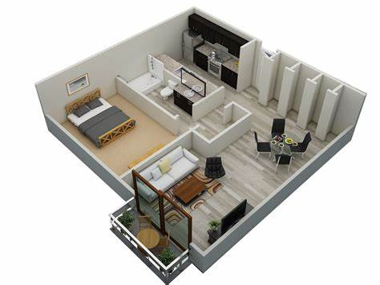

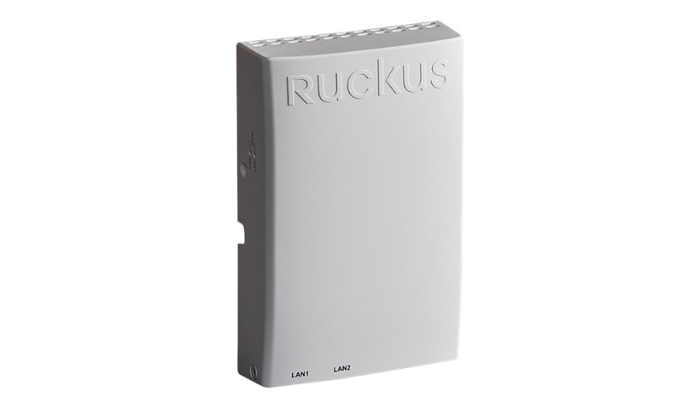
RESIDENT FACING SOLUTION:
Community Wi-Fi
Generates revenue with positive ROI
Reduces onboarding process for Smart Building and IoT technology onboarding.
Door Locks
Smart Thermostats
Voice Controls
Leak Detection
Smart Switches
Resident & Employee Safety Devices
Interact Technologies - Confidential & Proprietary - 2022

Slide 4
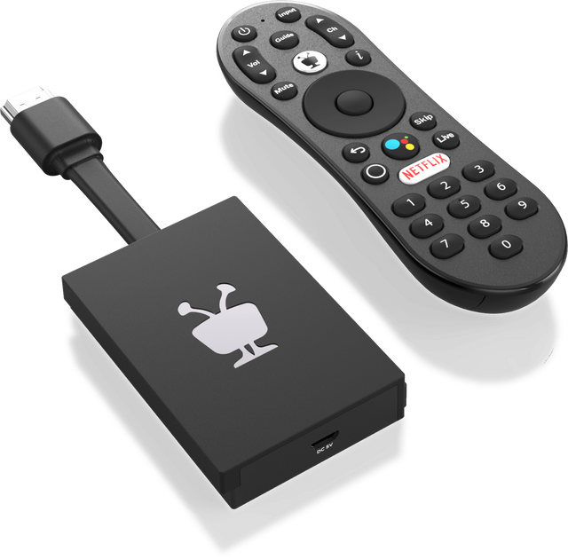
RESIDENT FACING SOLUTION:
TV
140 FTG Channels
IPG
Remote
Cloud DVR
Casting
Interact Technologies - Confidential & Proprietary - 2022

Slide 5
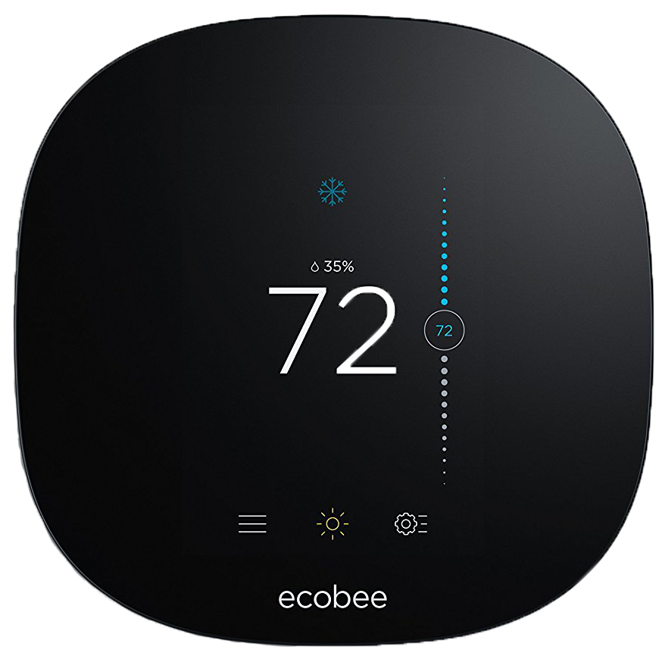
RESIDENT FACING SOLUTION:
Managed Wi-Fi
Secondary Check In Options: Phase l
Occupancy Sensor via Thermostat
Additional Occupancy Notifications
Resident changing Temperature
Resident changing Fan Speed
Resident Turning On or Off Thermostat
Wireless Door Contact
Smart Service Applications: Phase ll
**Resident Check In Application**
Interact Technologies - Confidential & Proprietary - 2022

Slide 6
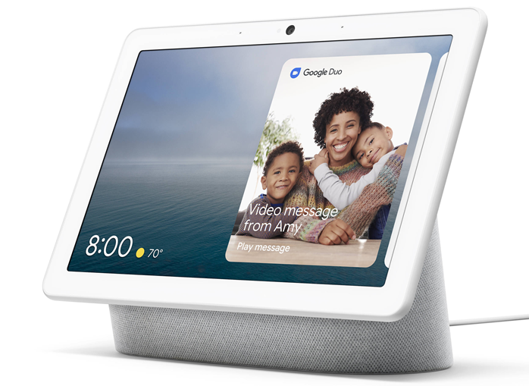
RESIDENT FACING SOLUTION:
Google Assistance Application
Voice Enabled Check-In
Voice Controlled Prompts For Resident Thermostat
**Voice Controlled Prompts For Dedicated Lighting**
Interact Technologies - Confidential & Proprietary - 2022

Slide 7

RESIDENT FACING SOLUTION:
Wireless Door Contact
ZigBee Enabled
Wireless Door Contact
Interact Technologies - Confidential & Proprietary - 2022

Slide 8
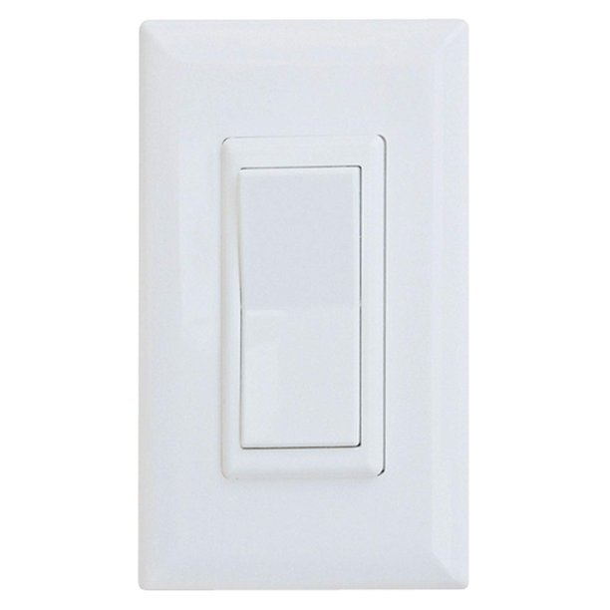
RESIDENT FACING SOLUTION:
Smart Dimmer Switch – Phase ll
ZigBee Enabled
Voice Control Via Google Assistant – 3rd Party API
Interact Technologies - Confidential & Proprietary - 2022

Slide 9

RESIDENT FACING SOLUTION:
Safety Device Panic System
Alerts
Incident Records
Updated Locations
Location Specific
Interact Technologies - Confidential & Proprietary - 2022

Slide 10

RESIDENT FACING SOLUTION:
Leak Detection
Alerts
Incident Records
Wi-Fi Connected
Interact Technologies - Confidential & Proprietary - 2022

Slide 11
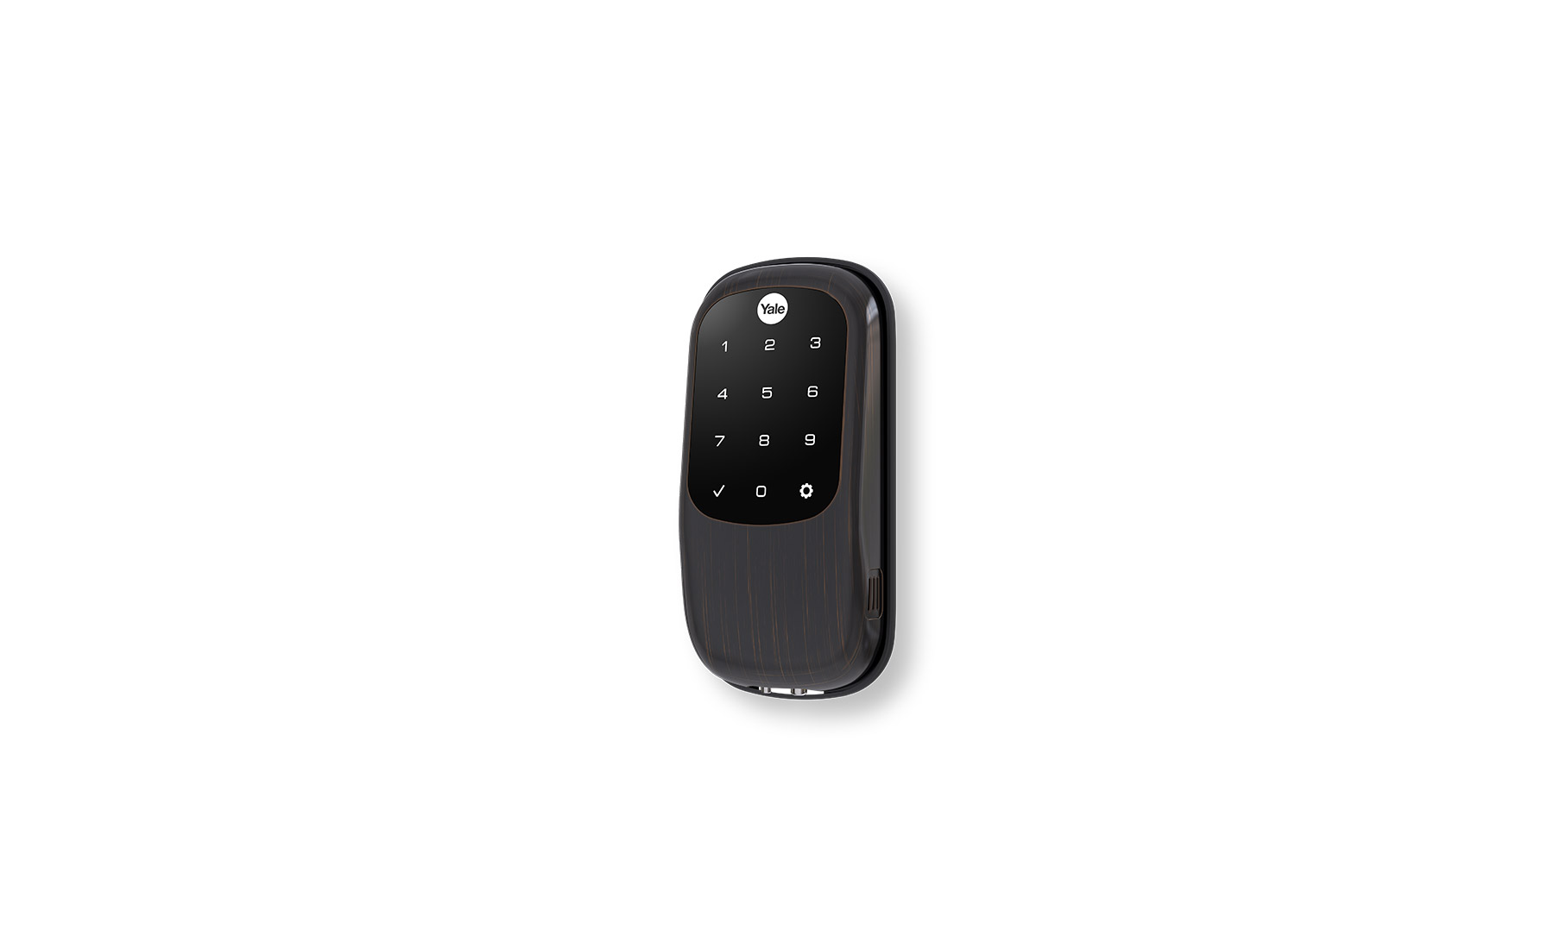
RESIDENT FACING SOLUTION:
Smart Door Lock
Alerts
App Based
Wi-Fi – BLE - Zigbee
Interact Technologies - Confidential & Proprietary - 2022

Slide 12
RESIDENT FACING SOLUTION:
Leak Detection
Alerts
Incident Records
Wi-Fi Connected
Wireless Door Contact
ZigBee Enabled
Wireless Door Contact
Managed Wi-Fi
Secondary Check In Options: Phase l
Occupancy Sensor via Thermostat
Additional Occupancy Notifications
Resident changing Temperature
Resident changing Fan Speed
Resident Turning On or Off Thermostat
Wireless Door Contact
Smart Service Applications: Phase ll
**Resident Check In Application**
Smart Door Lock
Alerts
App Based
Wi-Fi – BLE - Zigbee
Safety Device Panic System
Alerts
Incident Records
Updated Locations
Location Specific
Community Wi-Fi
Generates revenue with positive ROI
Reduces onboarding process for Smart Building and IoT technology onboarding.
Door Locks
Smart Thermostats
Voice Controls
Leak Detection
Smart Switches
Resident & Employee Safety Devices
Smart Dimmer Switch – Phase ll
ZigBee Enabled
Voice Control Via Google Assistant – 3rd Party API
Google Assistance Application
Voice Enabled Check-In
Voice Controlled Prompts For Resident Thermostat
**Voice Controlled Prompts For Dedicated Lighting**
TV
140 FTG Channels
IPG
Remote
Cloud DVR
Casting
Interact Technologies - Confidential & Proprietary - 2022

Slide 13
Thank You
For
Watching
Interact Technologies - Confidential & Proprietary - 2022

